Slide 1
Digital Client Onboarding Stream
Small Business Lending Project
Project Kick off
Date: August 2020

Slide 2
Project Background
Benefits
Project Scope Overview
Measures of Success
Constraints/Dependencies
Assumptions/Risks
High Level Timeline
Project Team
Thank You
Appendix
  Issue Management and Escalation
  Project Management Methodology
Kick Off

Slide 3
Welcome to the Digital Program
Small Business Lending Project

Slide 4
Project Background
The Small Business Lending Project is part of the overall Digital Program and the Digital Client Onboarding (DCO) Program stream. The DCO Program stream includes the following Projects:
Motive/Personal/In Branch DCO
Small Business DCO
    Small Business/Personal/Commercial Digital Banking
Small Business Lending
The purpose of this Program stream is to enhance and implement the Temenos digital client onboarding and digital banking platform called Infinity.
Problem Statement: The current Small Business Lending service is manual and needs to be conducted in/by a branch. There is no current functionality for a client to apply for a loan online independently.

Slide 5
High Level Benefits
The following high level benefits have been identified:
  Providing our clients value proposition in acquiring small loan business capital (<250k)
  Additional benefits will be defined once the lending partner is chosen

Slide 6
Project Scope Overview
The scope of the Small Business Lending project will be to integrate the selected loan partner into the DCO and Digital Banking streams. This will entail:
It is expected that the lending partner will have responsibility for setup and adjudication of the SB client (To be confirmed in RFP selection). A redirect will be provided to the lending partner from the SB DCO application flow, which may include passing of some client data and information (dependent on partner capabilities);
Integration of the loan partner into the Digital Banking stream to provide clients the ability to view attributes relating to their loan e.g. loan amount, balance, payment, etc.;
Requirements Definition;
Solution design;
Development including APIs to integrate into the Infinity platform and T24 as required;
Testing
Training
Deployment

Slide 7
Measures of Success
Scope
The scope of the project aligns to the Project Statement and managed within the PMO framework.
Time
Delivery of the project within the planned schedule.
Budget
The project is completed within budget.
Quality
The small business lending service is implemented per the agreed to requirements.
Benefits
Achieve the benefits identified in the Project Statement.
Success rate with clients utilizing new Partner platform.

Slide 8
Constraints/
Dependencies
Constraints
To be implemented with the Small Business DCO and small Business Digital Banking.
Dependencies
Digital Banking Project for Small Business; and
Digital Client Onboarding project for Small Business.

Slide 9
Risks/Assumptions
RISKS | MITIGATION STRATEGY
Solution does not meet business needs | Define business requirements and assess against product.
Inadequate testing due to complexities and dependencies of systems | Establish a formal test plan with dedicated test lead to facilitate each of the testing cycles.
Application may not function as expected | Testing will be performed on applications to ensure they function as expected. Any issues identified will be addressed prior to deployment.
Resource Constraints with same team members on DCO and Digital Banking. | Will work with the schedule to align resources as best as possible to minimize project impacts.
Fulfilment of lender to provide our clients satisfactory service | Put in place SLAs and monitor.

Slide 10
Digital Program – Roadmap Summary
2019
2020
2021
Nov
Jan
Mar
May
Jul
Sep
Nov
Jan
Jan 29
Mar
May
2019
Motive DCO - Friends & Family Launch
Note: Dates may shift over 2020/21 as the team iterates
2021
Today
June 22, 2020
75 days
Motive DCO Project – Initial Implementation
Motive DCO - Full Launch
July 13, 2020
Dec 9, 2019
Personal DCO - Friends & Family Launch
Aug 17, 2020
116 days
Personal Online DCO Project & Motive DCO Project – Full Implementation
Personal Online DCO – Full Launch
Dec 9, 2019
Sep 14, 2020
Personal In Branch DCO Project - Full Implementation
201 days
May 2020
Oct 2020 - TBC
Small Business DCO Project (Go Live Ready)
130 days
Program Stream 1
Jun 1, 2020
Nov 2020
Digital Client Onboarding (DCO)
Small Business Lending Project (Go Live Ready)
Aug 18, 2020
December 2020
129 days
Small Business + Personal Banking Pre-Planning
54 days
Small Business Banking Launch
(Initial Focused Launch)
Jan 6, 2020
Mar 19, 2020
Small Business Banking Implementation
225 days
Mar 20, 2020
Jan 2021
Personal Banking Implementation (Go Live Ready)
246 days
Mar 20, 2020
Feb 2021
Program Stream 2
Corporate Banking Implementation (Go Live Ready)
192 days
Digital Banking (DB)
Oct 5, 2020
Jun 2021

Slide 11
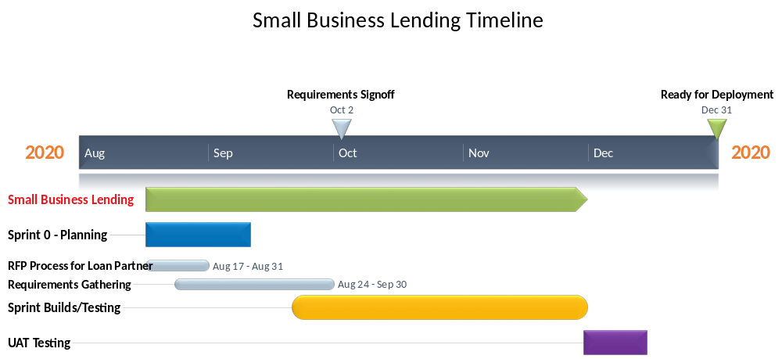
High Level Estimated Timeline – Small Business Lending

Slide 12
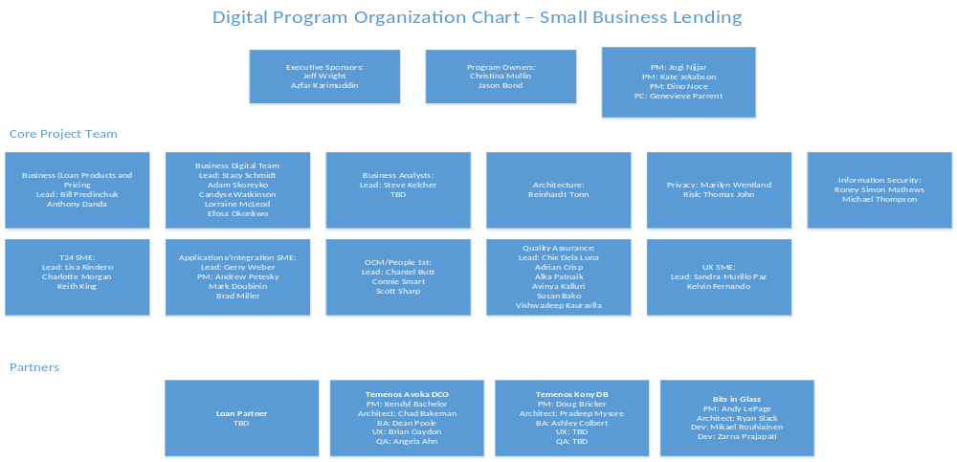
Project Organization

Slide 13
Thank You

Slide 14
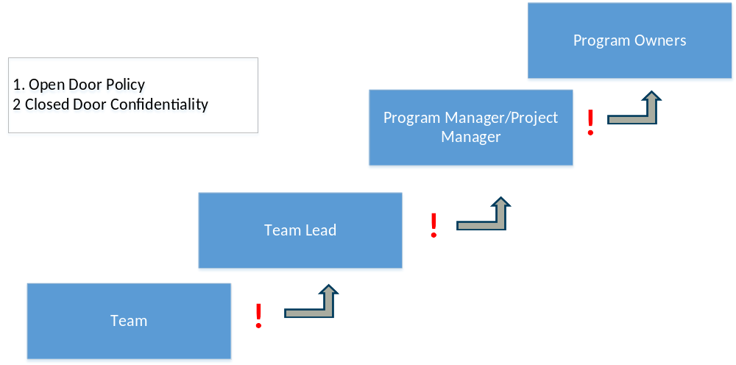
Issue Management and Escalation Process

Slide 15
Project Management Project Delivery Lifecycle
Project Kick off
Project Statement
New Initiative/Change Risk Assessment Tool
Monitoring and Controlling ensuring controls are in place to manage the project work
Performing Integrated Change Control
Initiation Phase
Project Management Plan
Develop project schedule and plans
SDLC: Requirements Gathering
Planning Phase
Monitoring and Controlling Phase
Direct and manage the work
Manage Communications
Perform quality assurance
Conduct procurement
SDLC: Design, Build, Test, Go Live
Execution Phase
Close of project or phase
Lessons Learned Report
Closure Report
Closure Phase

